Slide 1

Liu Liu Megatech
Team 6

Slide 2
The Project
Liu Liu Megatech was assigned the task to create and implement an automated software (BAPERS) for BIPL
BAPERS is a collection of functions integrated in a single piece of software that:
Accept and Process Jobs
Generate Reports
Take payments
Manages Customer Accounts

Slide 3
Meet the team…

Slide 4
Gerda – Project Manager/Systems Analyst
Gabriel – Deputy project manager/Designer
Mugheeth – Designer/Tester
Patrick– Tester/Systems Analyst
Christopher – Programmer/Designer
Edgar – Programmer/Systems Analyst
Notes:
Introducing each of the members “our team” and the project we are working on which is BAPERS.
Explaining a bit about how the team
4

Slide 5
How the Project Went…

Slide 6
Started off with organising the roles based on everyone's strengths in the group
We set up meetings twice a week, one on the day of our consultant meeting (Thursday) and usually a Monday when we were all at university.
We divided up tasks for that week and set deadlines to ensure we were on top of tasks that were needed to be completed. We were able to check up on progress through GitHub and also through social media such as WhatsApp.

Slide 7
Problems encountered…

Slide 8
Maintaining consistency
Avoiding it in the future: Check the work throughout the project
Coming to an agreement on final diagrams and documents
Notes:
Consistency – SRD, there were issues with the use case specs as they didn’t match the GUI in terms of the functionalities.
We could have spent more dedicated time to making sure it was consistent. Spent more time checking the document.
With the GUI designs- we are missing functionalities that are required, there is a more suitable layout and a better user friendly approach.
We set up meetings twice a week, one on the day of our consultant meeting (Thursday) and usually a Monday when we were all at university.
We divided up tasks for that week and set deadlines to ensure we were on top of tasks that were needed to be completed. We were able to check up on progress through GitHub and also through social media such as WhatsApp.
8

Slide 9
Teams Contributions
Christopher – ER diagram, Design Class, implementation
Edgar – SQL statements, implementation
Gabriel – GUI designs, GUI implementation, presentation
Gerda – SRD document, GUI implementation, presentation
Mugheeth – Testing/SRD document
Patrick – Testing/use case indexing, GUI CSS, presentation
Group Contributions – Use Case diagram, use case specs
Notes:
Although we had our roles, we all contributed in other parts of the 1st deliverable. Checking over eachothers work etc
9

Slide 10
Lessons Learnt…

Slide 11
Organisational: setting deadlines and assuring the workload is spread evenly amongst team members.
Arranging meetings that are suitable for each team member
Project Management: keeping track of each team members progress throughout the project and also assuring good work is produced at the end of it.
Technical: Each team member made mistakes during the project when it came to designing diagrams but this was an opportunity to gain help from other team members to fix mistakes and avoid making future ones.
Technical: Using GitHub, JavaFX

Slide 12
Looking into the Future…

Slide 13
Organizationally: meet up with the team more frequently in particular for 1st deliverable.
Technical: for the 1st deliverable we would not use GitHub because it was too complicated to use for certain team members. Google drive would have been useful as many people can work on a document at once and generally team member were more familiar using it.

Slide 14
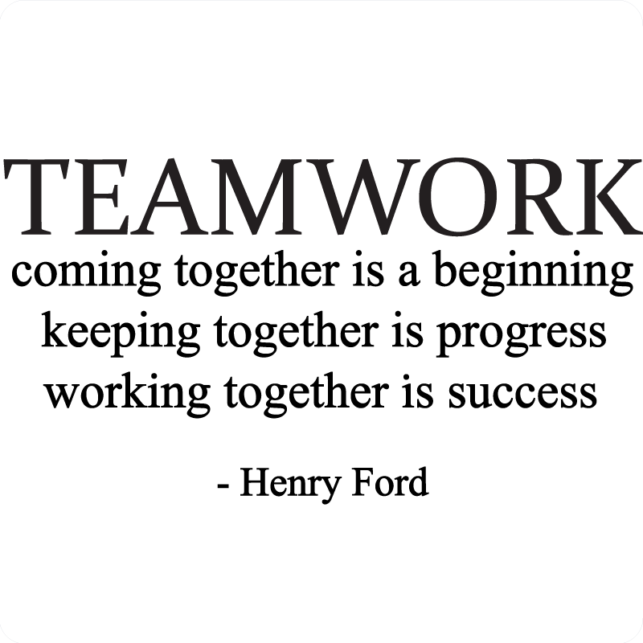
Our Teams Success

Slide 15
Finished use case diagram in 2 days working as a team
Got parts of the implementation working first time
Design class
Notes:
15

Slide 16
Challenges

Slide 17


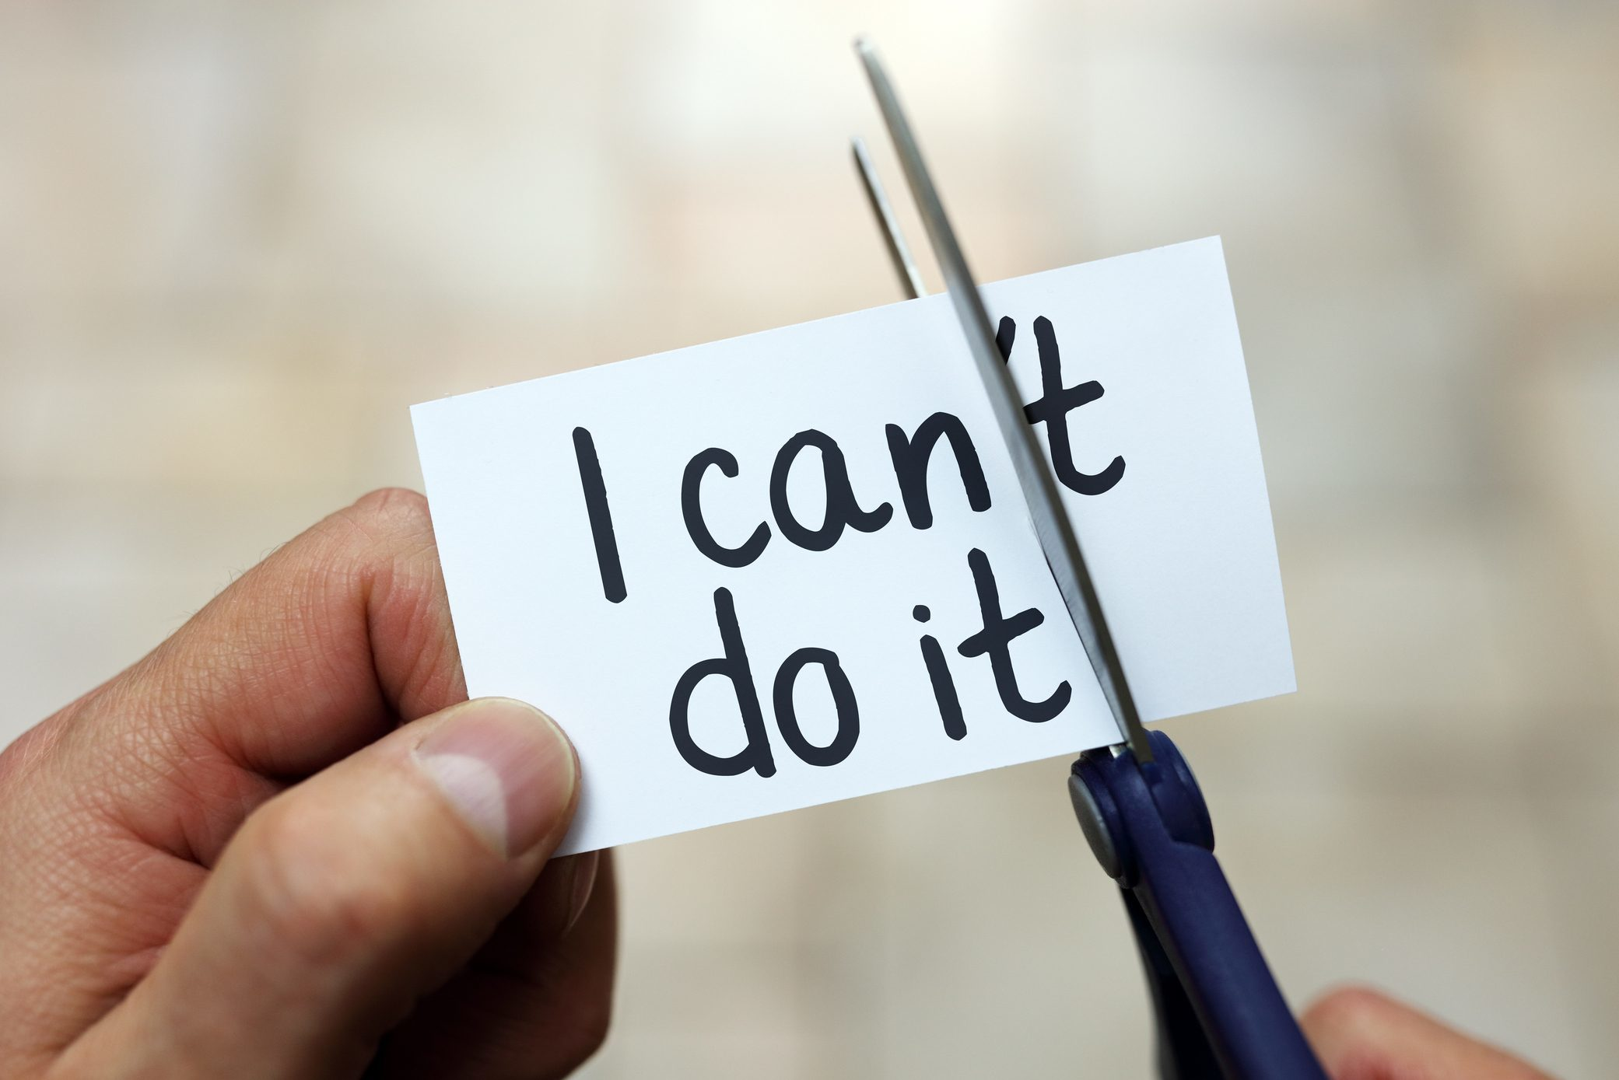
Database – SQL statements
Use case indexing: we had multiple versions and it took us a long time to create a final version
Changing the initial designs of the GUI from the 1st deliverable in the implementation to make sure all viable functionalities were covered
Component Diagram
Notes:
Edgar redid it when we asked vlad the first time and then that resulted in more work
17

Slide 18
Conclusion
Learn to adapt
Learn to work in a team
Learn to deal with pressure
Notes:
We are happy with the team m
18

